Slide 1

MICROSOFT MOVIE STUDIO ANALYSIS
Sabina Bains
October 2021

Slide 2
SCOPE (OBJECTIVE)
J
J
J
J

Slide 3
Methodology

Slide 4

OVERALL FINDINGS

Slide 5
Key findings
Animation, Adventure, and Family genres generate the highest profits while maintaining low costs on average.
Utilizing experienced crew members in these genres such as Pierre Coffin as Director, Janey Healy as Producer, and Michael Giacchino as composer will yield successful films.
Film releases in May generate the highest worldwide gross on average.

Slide 6
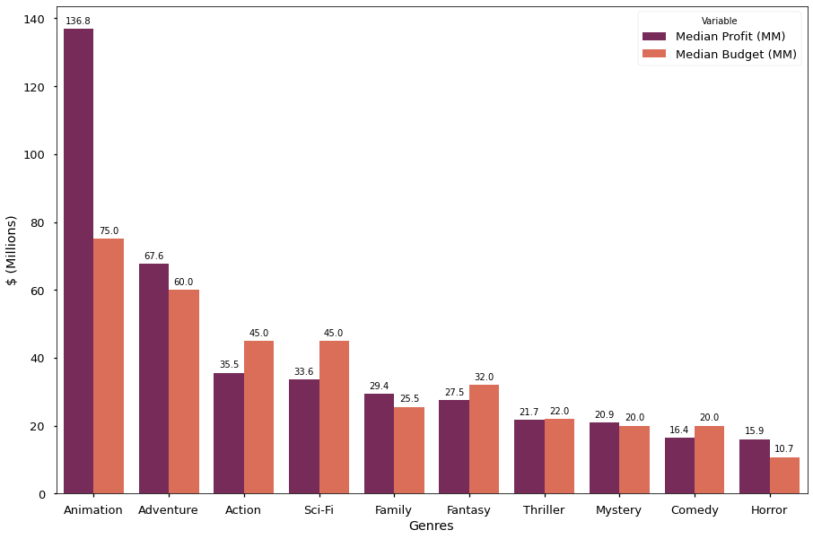
Films in the Animation genre are most profitable on average, while costing about half their NET earnings
Animation films outperformed all other genres with a median profit of 136.8MM. Median budget for this genre was 75MM.
Adventure and Family have high average profits as well while keeping low costs
Action, Sci-Fi, Fantasy, and Comedy genres have higher budgets than profit on average
Using the median rather than the mean excludes potential outliers in films, demonstrating Animation films as a clear winner

Slide 7
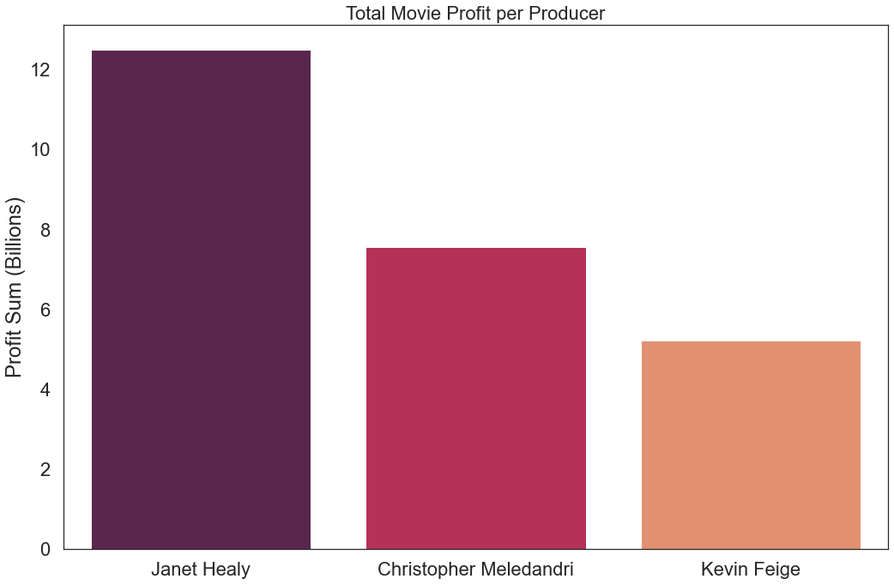
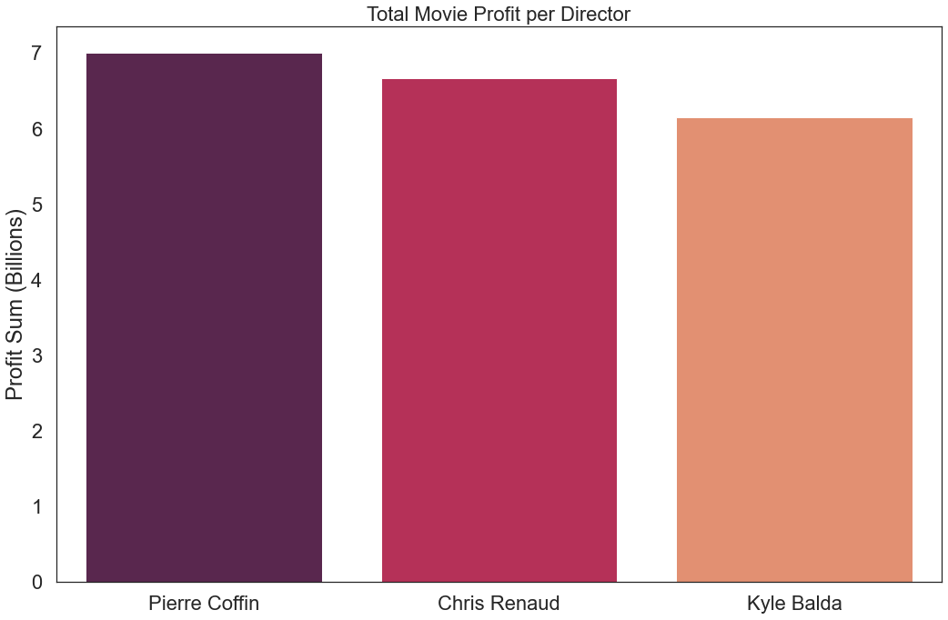
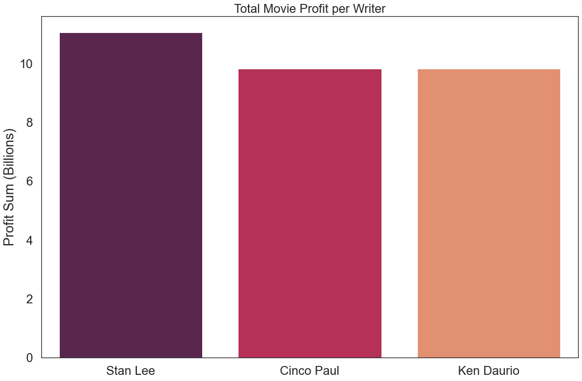
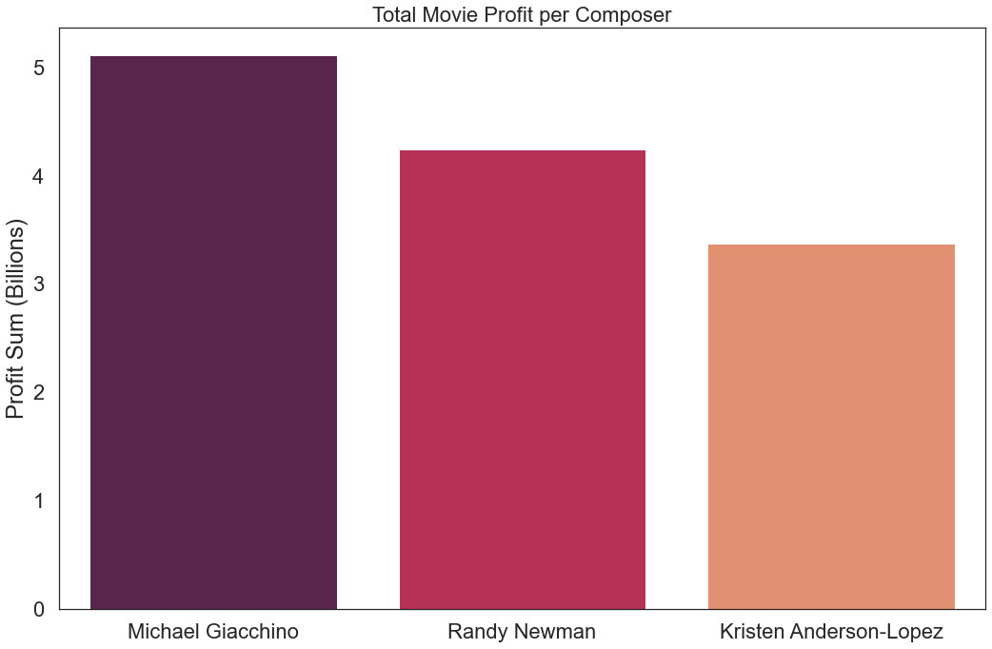
Hiring experienced crew members will contribute to successful films
Janet Healy is the most profitable producer with 7 works in the Animation Genre.
Pierre Coffin is the most successful Director in the Adventure, Animation, and Comedy Genres.
Cinco Paul and Ken Daurio write the most successful Animation, Adventure, and Comedy films
Michael Giacchino tops the list of most successful composers, with experience composing 6 works that vary in Genre

Slide 8
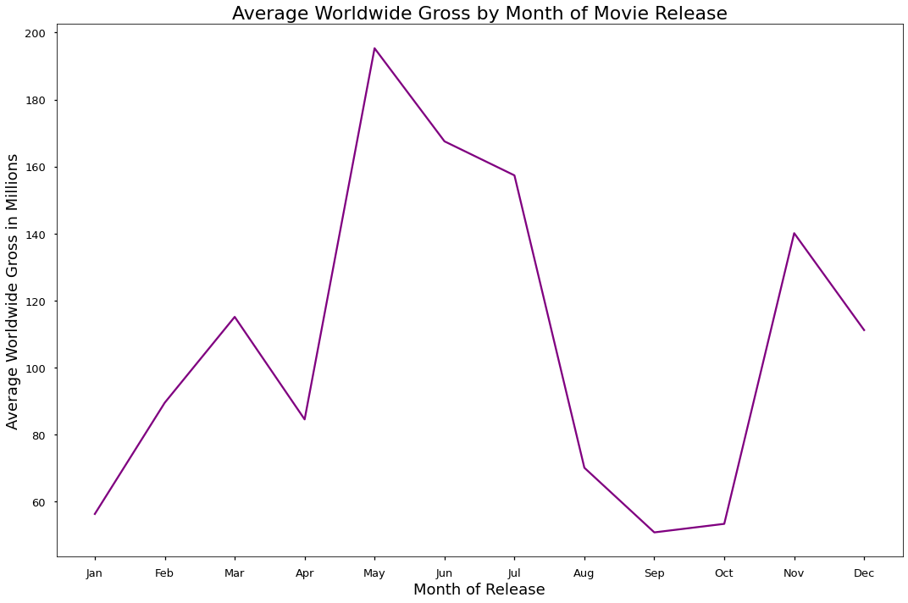
MAY FILM RELEASES GENERATE THE HIGHEST WORLDWIDE GROSS ON AVERAGE
Movies released in late spring to early summer generate substantial worldwide gross, with May being the highest on average at 195MM.
Late summer and early fall movie releases yield the lowest worldwide gross on average
Release Month | Gross (MM)
Jan | 56.3
Feb | 89.5
Mar | 115.1
Apr | 84.5
May | 195.3
Jun | 167.5
Jul | 157.3
Aug | 70.1
Sep | 50.7
Oct | 53.3
Nov | 140.1
Dec | 111.1

Slide 9
Recommendations and next steps:
Animation, Adventure, and Family genres generate the highest profits while maintaining low costs on average.
Utilizing experienced crew members in these genres such as Pierre Coffin as Director, Janey Healy as Producer, and Michael Giacchino as composer will yield successful films.
Microsoft should avoid delaying movie releases to late summer and fall seasons and should prioritize releasing films in May, June, or July, as viewers are more likely to hit the movie theatre then.

